Slide 1

Introduction to Machine Learning
From raw data to predictive models
Yordan Darakchiev
Technical Trainer
iordan93@gmail.com

Slide 2
Table of Contents
sli.do: #ml-intro
The scientific method – overview
Knowledge discovery from data
Machine learning
Basic concepts
Algorithms (models) overview
Setting up the work environment
Getting, preparing and exploring data
Basic principles and guidelines

Slide 3
The Scientific Method
How to work with data… the right way

Slide 4
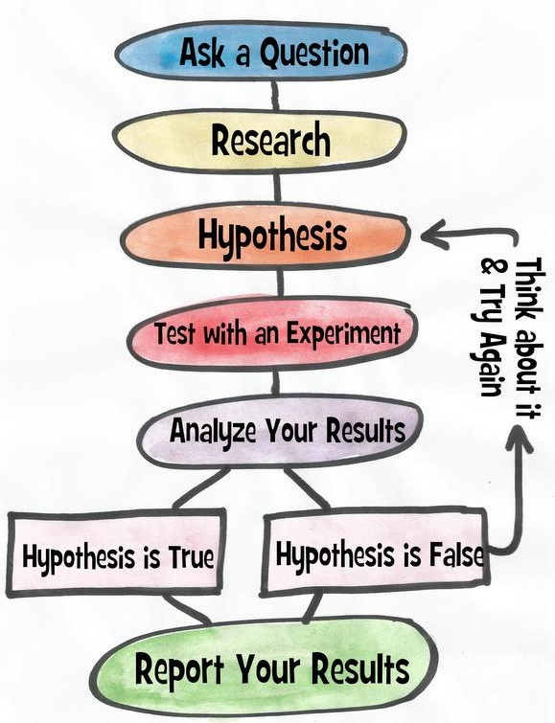

The Scientific Method Steps
Ask a question
Do a research
Form a hypothesis
Test the hypothesis with an experiment
Experiment works $⇒$ Analyze the data
Experiment doesn't work $⇒$ Fix experiment
Results align with hypothesis $⇒$ OK
Results don't align with hypothesis $⇒$ new question, new hypothesis
Communicate the results

Slide 5
OSEMN Model
Some guidelines on the process to extract meaningful information from data
Very similar to the scientific method
Can be viewed as a sequential process
Or just as some guidelines on how to do research
Read as "awesome"
Obtain data
Scrub data
Explore data
Model data
iNterpret the results

Slide 6

Applied Machine Learning Process
This allows us to do our job faster and more reliably
Problem definition
Make sure the problem is well-defined and that you're solving the right problem
Data analysis
Get familiar with the available data
Data preparation
Get the data ready for modelling
Algorithm evaluation
Test and compare algorithms
Result improvement
Use results to create better models (e.g. fine-tuning, ensembles)
Result presentation
describe the problem and solution to non-specialists

Slide 7
Machine Learning
Fundamental concepts

Slide 8
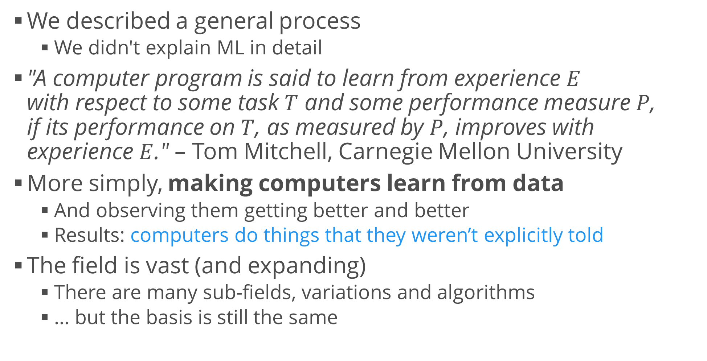
Machine Learning
We described a general process
We didn't explain ML in detail
"A computer program is said to learn from experience $E$ with respect to some task $T$ and some performance measure $P$, if its performance on $T$, as measured by $P$, improves with experience $E$." – Tom Mitchell, Carnegie Mellon University
More simply, making computers learn from data
And observing them getting better and better
Results: computers do things that they weren’t explicitly told
The field is vast (and expanding)
There are many sub-fields, variations and algorithms
… but the basis is still the same

Slide 9
Types of Machine Learning Algorithms
Supervised learning
We train the program on previously known (labelled) data
After training, we expect it to make predictions on new data
Examples: regression, classification
Unsupervised learning
We leave the program to find patterns in data
Examples: clustering analysis, dimensionality reduction
Reinforcement learning
A form of unsupervised learning
The program learns continuously
Examples: learning to play a game by observing other players, learning to drive a car

Slide 10
Algorithms by Task
Statistical algorithms
Regression – predicting a continuous variable
Classification – predicting class labels
Clustering – finding compact groups of data points
Dimensionality reduction – simplifying the input data
Recommendation – suggest items for users
Optimization – minimize / maximize a target function
Testing and improvement algorithms – helper algorithms to select, fine-tune and optimize other ML algorithms
… and more :)

Slide 11
Environment Setup
Download and install all tools

Slide 12

Anaconda
You can install the Python interpreter and all libraries manually
Hard, boring and repetitive work
Error-prone
Easy solution: platforms like Anaconda
Provide everything you need to get started with Python for science: interpreter, packages (720+), package manager, IDE
Download from https://www.continuum.io/downloads
Current version (March 2018): Anaconda 5.1
Choose your platform (Windows, Linux, or MacOS)
Download the Python 3.6 version
Follow the installer

Slide 13
Python Tools for Visual Studio (Optional)
You can use the built-in IDE called Spyder
You can even use Notepad if that's your thing
If you want to use another IDE, you have to configure it to work with Python
Syntax highlighting, autocomplete, etc.
If you're using Visual Studio
Python Tools
https://www.visualstudio.com/vs/python/
Visual Studio Code
If you prefer something lightweight, Visual Studio Code is a good alternative
https://code.visualstudio.com/docs/languages/python

Slide 14

Jupyter Notebook
A very nice and clean way to document your research
Included in Anaconda
Can create documents that contain live code, equations, visualizations and explanatory text
HTML / CSS / JavaScript
Markdown
Python
Start – use the Anaconda shortcut
…or type into the Command Prompt
jupyter notebook

Slide 15

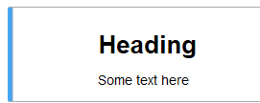

How to Use Jupyter
Create a new notebook
New > Python 3
Every piece of text or code is in a cell
Text cells just contain text or Markdown
Code cells contain code (obviously)
Code can be executed
Jupyter "remembers" the code
Execute cell: Ctrl + Enter
Or use the menus

Slide 16
Getting and Preparing Data
Preparing raw data for modelling

Slide 17
Common Libraries
In Python, we use libraries to perform common operations
scikit-learn – machine learning models
pandas – working with data
Reading, tidying, cleaning, preparation
numpy and scipy – numerical and scientific libraries
Contain a ton of useful functions for performing research
matplotlib – plotting and data visualization
There are many more we'd like to use but these are the most commonly used ones

Slide 18
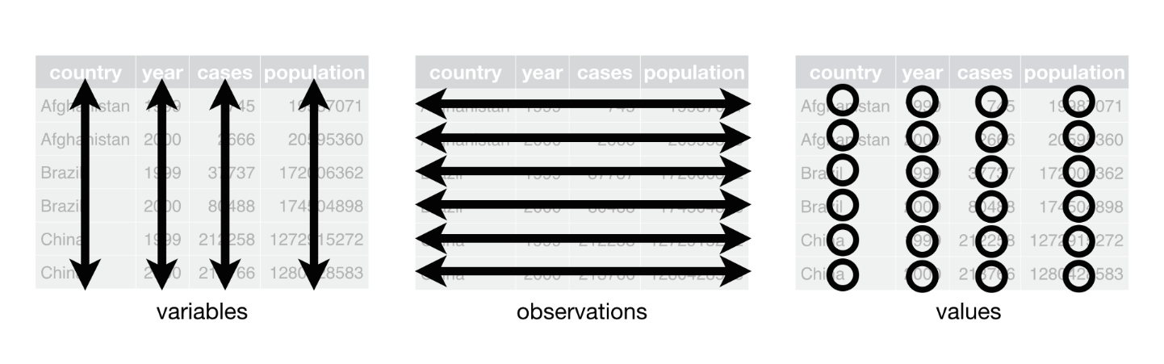
Getting Data
Import pandas in your notebook or script
We usually give it an alias to make code shorter
Read a dataset (table with data)
The method contains a lot of options
We can also read from other (non-local) sources
Transform the data to make analysis easier
Tidy up the data
Attributes in columns
Observations in rows
Adding a new record = adding a single, complete row
import pandas as pd
dataset = pd.read_table(...)

Slide 19
Preparing Data
Make other transformations as needed
Incorporate many datasets
Filter rows and columns
Group and aggregate values (e.g. sums by group)
Transform columns (e.g. apply a function to all values)
Change data types
Alter the distributions (e.g. log, minmax)
Calculate new columns (e.g. sum of two columns)
All of these transformations are commonly used and have their own methods within pandas
10 Minutes to pandas
Pandas Cheat Sheet
Full docs

Slide 20

Exploring Data
Running an ML model is a small part of the process
Before that, we have to get to know our data
Exploratory data analysis (EDA)
"Playing around" with the data, looking for interesting features, distributions, correlations, causal relationships, etc. using "mind power"
An important part of EDA is creating graphs
We use matplotlib for this
Histograms and boxplots – to represent distributions
Line and bar charts – to represent relationships and allow comparisons
Scatterplots – to represent correlation
… and many others, depending on the case
We can even create our own charts if we need that

Slide 21
Example: Getting and Exploring Data
Passengers on the Titanic
Dataset provided in the additional materials: titanic.csv
Dataset info
Read the data (using pandas)
Tidy up and clean the data
While also exploring the information
No "hard and fast" rules – you've got to use intuition
Usual workflow: start by inspecting variables and data types, move to single-variable distributions, then try to find relationships between two or more variables; transform the data if needed
Deal with missing values and outliers, normalize the data if needed

Slide 22
Example: Preparing Data for Modelling
Most models require two additional steps
Convert categorical variables into indicator variables
Normalize values if needed (e.g. scale all variables from 0 to 1 using minmax scaling, or use Z-scores)
Perform other model-specific transformations
E.g. your model may not work well with highly imbalanced data (when you look for anomalies)
If possible, prepare several versions of the dataset with different transformations to see whether a transformation affects model performance negatively
Describe and document the entire process!
dataset = pd.get_dummies(dataset)

Slide 23
Example: AzureML
In this course, we’ll be using Python code to run and evaluate models
We’ll create a nice, structured pipeline
But there are other solutions
Microsoft AzureML Studio: https://studio.azureml.net/
Good for a demo if you’re not experienced in coding
Pros
Free to try
Easy, visual representation of the workflow
Has many predefined modules; can also execute Python code
Runs on the cloud – no need to throttle your machine
Cons
Hides away or obscures some important implementation details
Running on the cloud is too expensive sometimes

Slide 24
Summary
The scientific method – overview
Knowledge discovery from data
Machine learning
Basic concepts
Algorithms (models) overview
Setting up the work environment
Getting, preparing and exploring data
Basic principles and guidelines

